Slide 1
Pollutants and Media theme
Priority pollutants that enter the environment and accumulate in water, on land and in the biosphere

Slide 2
Environmental and Health Impacts

Slide 3
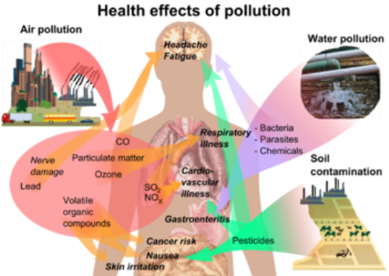
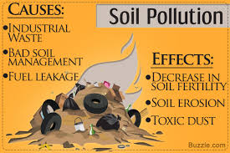
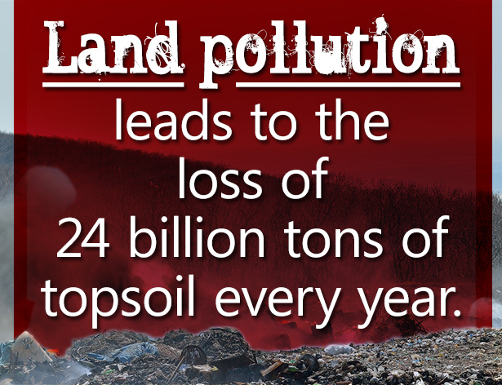
Environmental and Health Impacts
Global estimates of total degraded land range widely from less than 1 Gha to over 6 Gha.

Slide 4
Wastewater/Water Treatment Technologies

Slide 5
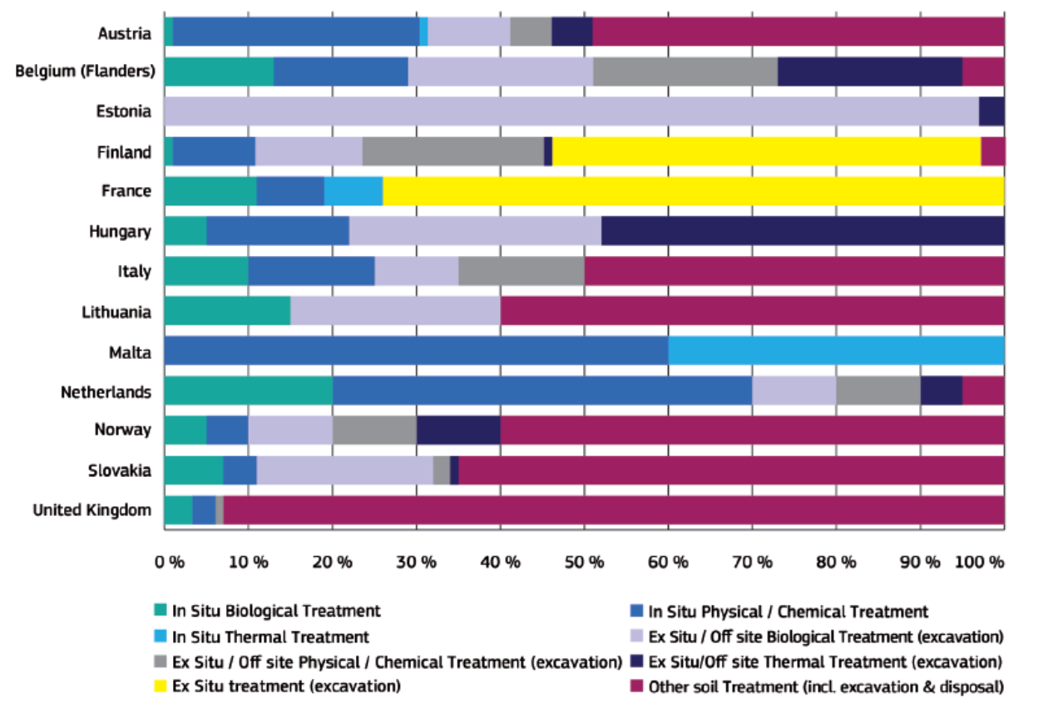
Soil Remediation Treatment Technologies

Slide 6
Theme aim and objectives
To identify key pollutants and potential emerging technologies for their treatment;
To prioritise the research needs and develop a road map and a white paper for implementation;
To identify and interact with all stakeholders in promoting solutions and influencing policy
The theme links closely to the Bioscience to Engineering and the Technological Interface themes

Slide 7

Challenges and Opportunities
Scale and cross sectoral challenges
Options for low carbon, sustainable remediation still limited
Micropollutants, Mixtures and Gross contamination (i.e. plastics)
Potential for integrated biotechnological solutions proven but still limited implementation
Bio-based remediation could provide environment-friendly and cost-effective solutions

Slide 8
Challenges and Opportunities
Understanding of the sources, fate and transport, and risk of new and emerging chemical mixtures
Design of effective and sustainable treatment technologies
Guidance and tools for monitoring and remediation of contaminants (i.e. biosensors vs bioreporters, early warning systems)
Enabling risk managers, engineers and policy makers to make better-informed decisions on the appropriate uses of chemicals and levels that can prevent environmental and human health problems

Slide 9
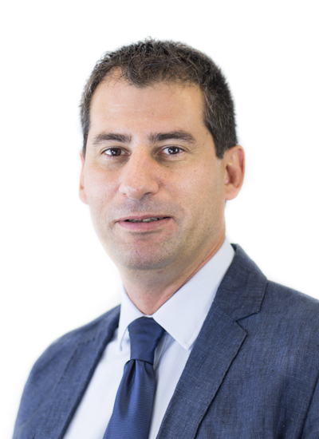
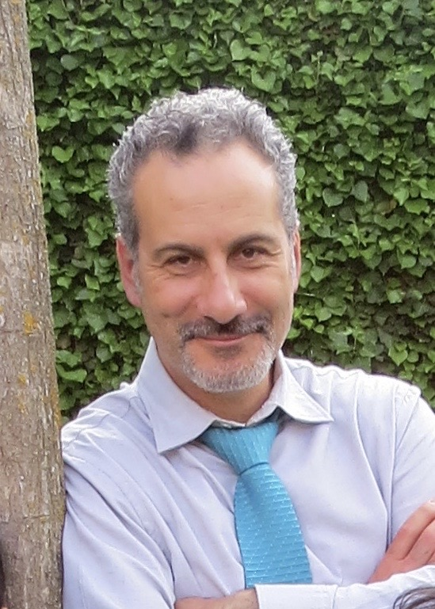
Get in touch
Prof Frederic Coulon
Cranfield Water Science Institute
Faculty of Engineering and Applied Sciences
Email: f.coulon@cranfield.ac.uk
Telephone: +44 (0)1234 754 981
Prof Tony Gutiérrez
Heriot-Watt University
School of Engineering & Physical Sciences
Email: Tony.Gutierrez@hw.ac.uk
Telephone:+44 (0) 131 451 3315

